Slide 1

AI Agents Hackathon
April 8 - 30
Build, innovate and #HackTogether
aka.ms/agentshack
In partnership with
Notes:
Welcome to the AI Agents hackathon live streams!
The AI Agents hack is a free virtual event running from April 8-30.

Slide 2
Four weeks of learning & hacking!
aka.ms/AgentsHack
7
MONDAY
8
TUESDAY
9
WEDNESDAY
10
THURSDAY
11
FRIDAY
12
SATURDAY
13
SUNDAY
Week 1
Kickoff
Guiness record!
Azure AI Agent
Java Agents
M 365 Copilots
Semantic Kernel
.NET Agents
Hack!
Hack!
Hack!
14
MONDAY
15
TUESDAY
16
WEDNESDAY
17
THURSDAY
18
FRIDAY
19
SATURDAY
20
SUNDAY
Hack!
JS Agents
AutoGen
.NET Agents
Cosmos DB
Copilot Studio
Azure AI Models
Code Interpreters
Langchain4J
Agentic Voice
Hack!
Hack!
Hack!
Week 2
21
MONDAY
22
TUESDAY
23
WEDNESDAY
24
THURSDAY
25
FRIDAY
26
SATURDAY
27
SUNDAY
Week 3
Llamaindex.TS
Prompty
Azure SQL
SignalR + SK
PostgreSQL
Agentic RAG
Multi-DB Agents
Azure Functions
Real-time ACS
Robotic agents
Hack!
Hack!
Hack!
28
MONDAY
29
TUESDAY
30
WEDNESDAY
We will also hold Discord office hours throughout the week.
Join the Azure AI Community on Discord here:
aka.ms/agentshack/discord
Week 4
Hack!
Responsible AI
Securing Agents
Evaluation
HACKS DUE!
11:59 PM PT
Notes:
We’re hosting over 20 live streams where you’ll learn how to build agents using various Microsoft technologies. At the end of the three weeks, submit your project for a chance to win fantastic prizes!
Now, let’s hear from our friends at Reactor...

Slide 3
Live streams in more languages
Spanish:
aka.ms/agentshack-es
Portuguese:
aka.ms/agentshack-pt
Chinese:
aka.ms/agentshack-zh
Azure AI Agents
.NET + Aspire
Azure AI Foundry Modelos
Semantic Kernel
GitHub Modelos
VoiceRAG
Azure AI Agents - Python
Azure AI Agents - JavaScript
欢迎参加AI代理黑客松
使用Azure AI Agent Service作为您的软件开发流程

Slide 4
Prizes 🏆
Prize amount is per team,
not per team member!
Category | Prize amount
Best Overall Agent | $20,000
Best Agent in Python | $5,000
Best Agent in C# | $5,000
Best Agent in Java | $5,000
Best Agent in JavaScript/TypeScript | $5,000
Best Copilot Agent (with Microsoft Copilot Studio or 365 Agents SDK) | $5,000
Best Azure AI Agent Service Usage | $5,000

Slide 5
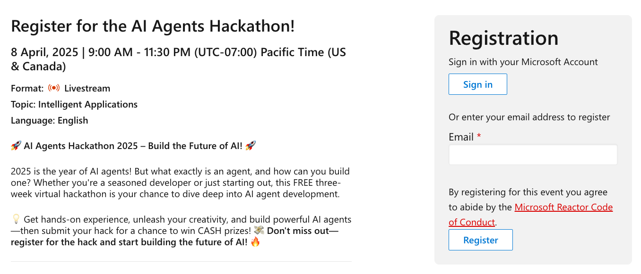
Register now
You must register to be eligible for prizes:
https://aka.ms/agentshack/register

Slide 6
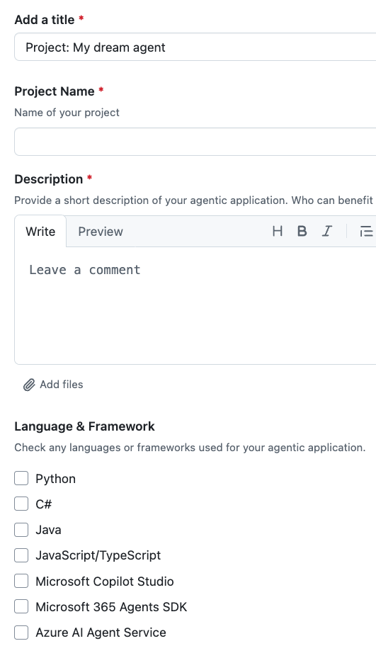
Submission process
Make sure you and any team members (up to 4 total) are all registered for the hackathon.
Before April 30th 11:59 PM PST, submit your hack using the process described @ https://aka.ms/agentshack/submit A project repository URL and short demo video is required, while a deployed endpoint is optional.
Wait a few weeks for judges to finish their scoring. We'll notify all participants when winners have been announced.

Slide 7
Agents 101

Slide 8
Intro to
Agents
AI agent
Frameworks
Design patterns
AI Agents
Tool use
For Beginners
Agentic RAG
Trustworthiness
Planning
Multi-agents
Metacognition
Agents in Production
aka.ms/ai-agents-beginners
Notes:
This part of the presentation is based in free agents curriculum that's available online, and is translated into portuguese too.
You can dive way more into these concepts after this talk from that link.

Slide 9
What can you build?
Notes:
Let's look at an example of what an agent can look like.

Slide 10






Demo: Contoso Creative Writer
Azure Monitor
Multiagent flow
Researcher agent
Azure OpenAI Service
Grounding with Bing
Azure AI Search
Products agent
Entrada del usuario
Azure Container Apps (ACA)
Response
Azure OpenAI Service
Azure AI Search
Writer agent
Azure OpenAI Service
Editor agent
https://aka.ms/creative-writer-agent
Azure OpenAI Service
Notes:
Here's a relatively simple multi-agent flow, involving a writer, researcher, and editor.

Slide 11
What is an AI agent?
Notes:
So that was an example of an agent, but what actually is an agent? It can be hard to define, but we'll try!

Slide 12
An agent in LLM-based applications is a semi-autonomous software entity leveraging large language models to perform specific tasks through natural language interaction.
Notes:
Here's one definition:
Um agente de IA é uma entidade de software semiautônoma que aproveita grandes modelos de linguagem para executar tarefas específicas por meio de linguagem natural.

Slide 13
Large
Language
Model
Performs
Action
Access to
Tools
Knowledge
Notes:
Here's another way of visualizing an agent:
an LLM that can perform actions, has access to tools, and has access to knowledge.
Large Language Models - The concept of agents existed before the creation of LLMs. The advantage of building AI Agents with LLMs is their ability to interpret human language and data. This ability enables LLMs to interpret environmental information and define a plan to change the environment.
Perform Actions - Outside of AI Agent systems, LLMs are limited to situations where the action is generating content or information based on a user's prompt. Inside AI Agent systems, LLMs can accomplish tasks by interpreting the user's request and using tools that are available in their environment.
Access To Tools - What tools the LLM has access to is defined by 1) the environment it's operating in and 2) the developer of the AI Agent. For our travel agent example, the agent's tools are limited by the operations available in the booking system, and/or the developer can limit the agent's tool access to flights.
Memory+Knowledge - Memory can be short-term in the context of the conversation between the user and the agent. Long-term, outside of the information provided by the environment, AI Agents can also retrieve knowledge from other systems, services, tools, and even other agents. In the travel agent example, this knowledge could be the information on the user's travel preferences located in a customer database.
That combination is very powerful and can help us automate many flows.

Slide 14
When to use AI agents?
Notes:
Let's look at some examples of when you'd want to use agents.

Slide 15
When to use AI agents?
Open
Ended
Problems
Multi-
Step
Processes
Improvement
over time
Notes:
These are three situations where agents can be beneficial:
Open-Ended Problems - If you have an open-ended problem, it can be hard to program with traditional if/else statements because it's not always clear what task should be tackled next. Instead, you can use an LLM to make the planning decisions.
Multi-Step Processes - These are tasks that require a level of complexity in which the AI Agent needs to use tools or information over multiple turns instead of single shot retrieval.
Improvement Over Time - These are tasks where the agent can improve over time by receiving feedback from either its environment or users in order to provide better utility.

Slide 16




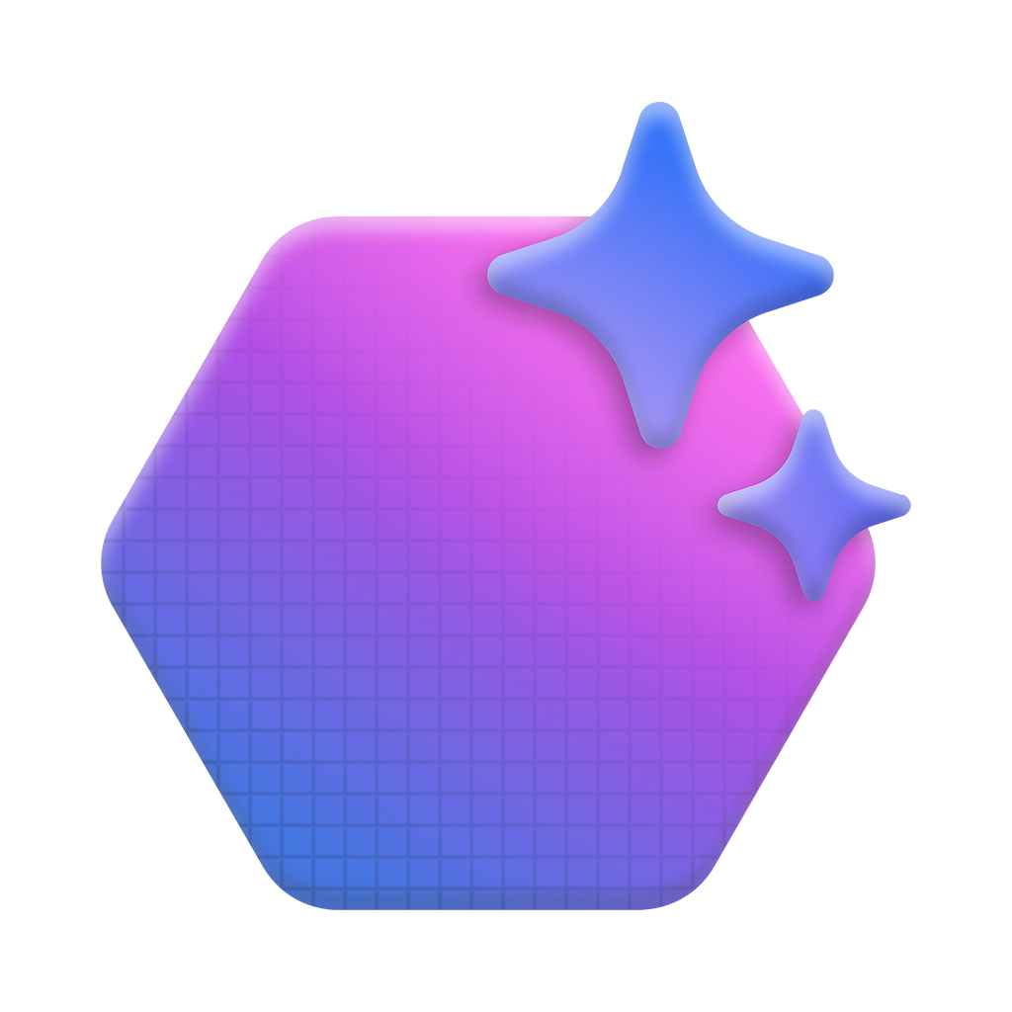


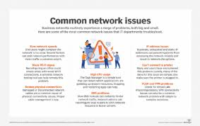
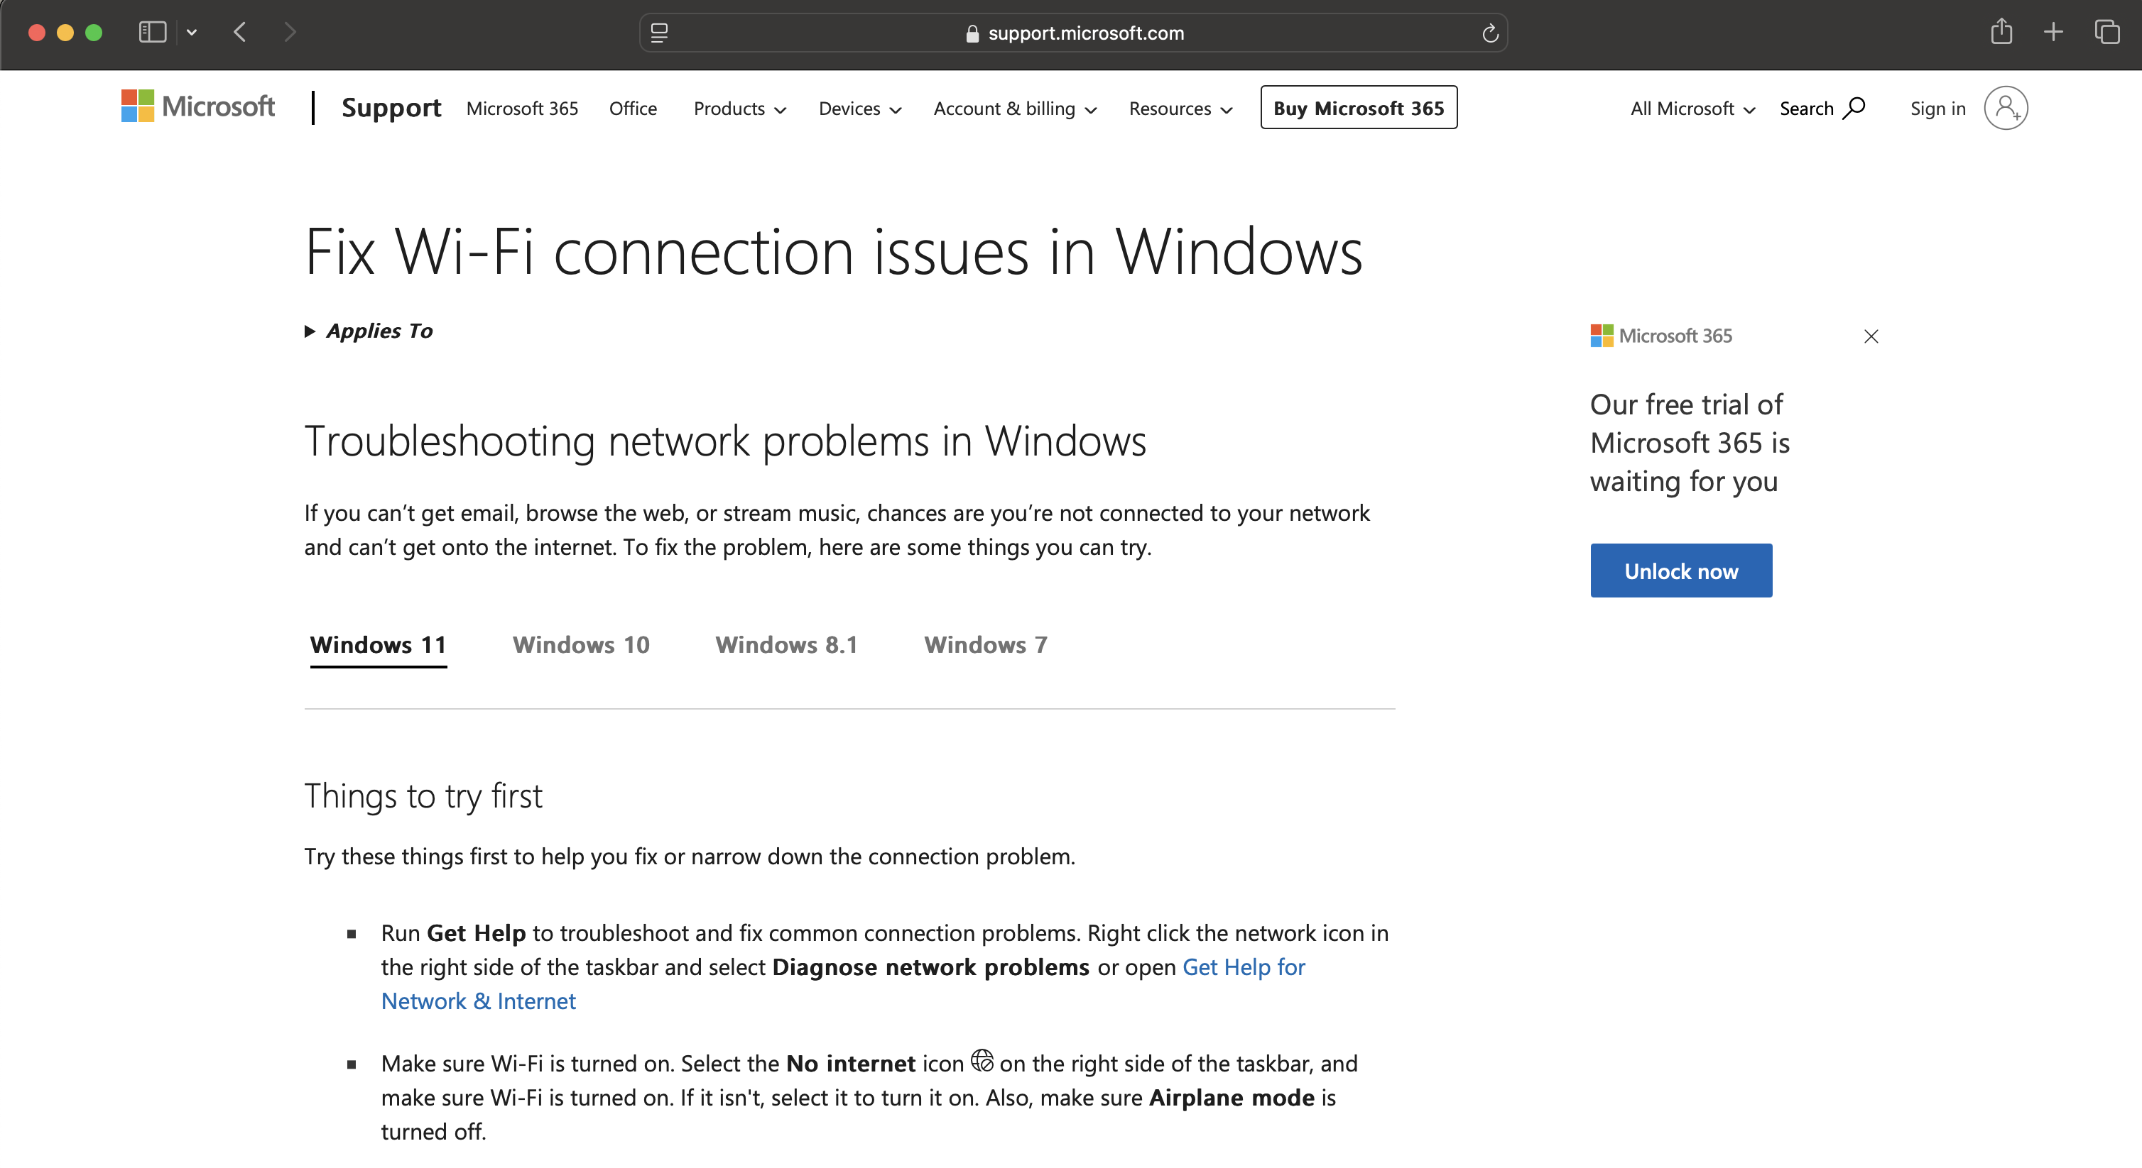
Agent sample Call center assistance
Dynamic Plan
1. Doc Agent → Search internal support documentation for error code "E-22" and Wi-Fi troubleshooting.
2. Video Agent → Locate and timestamp troubleshooting video content related to Wi-Fi connection and error code E-22.
3. Web Search Agent → Search external sources for recent discussions, tips, or product-specific issues regarding Wi-Fi and the error code.
Customer query
Internal Steps
from Documents
My SmartHome thermostat isn’t connecting to Wi-Fi, and I keep seeing an error code E-22. How can I fix this?
Query parsing
{ Wi-Fi }
Planner Agent
Video Link
and Timestamps
from Videos
LLM
{ Error: E-22 }
Azure AI Agent Service
AutoGen ou Semantic Kernel
{ Thermostat X10 }
Recent Online
Findings
from Web
Video agent
Docs agent
Web agent
Azure AI Agent Service
Azure AI Agent Service
Azure AI Agent Service
* We can use the Azure AI Content Understanding service to extract images and videos, and transform them from unstructured to structured data
Summarizes video clips
related to Wi-Fi and
error code E-22.
Gathers internal
troubleshooting steps.
Finds the latest external resources related to the issue
Notes:
Let's look at a specific example, an assistant for a call center. This system demonstrates how agents can collaborate dynamically to solve customer queries. The system starts with a query parsing agent, which interprets the user's request. The Planner agent then breaks down the task into specific sub-tasks, while agents like Doc and Web Search pull relevant documentation and online resources to assist the customer.
This dynamic, real-time orchestration of tasks by multiple agents enables the handling of complex customer service queries. The process is continuously evaluated by the system, ensuring the relevant data is fetched and presented in an actionable format.

Slide 17
How to start building AI agents?

Slide 18
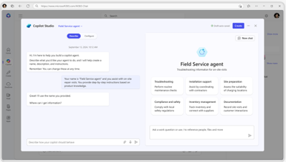
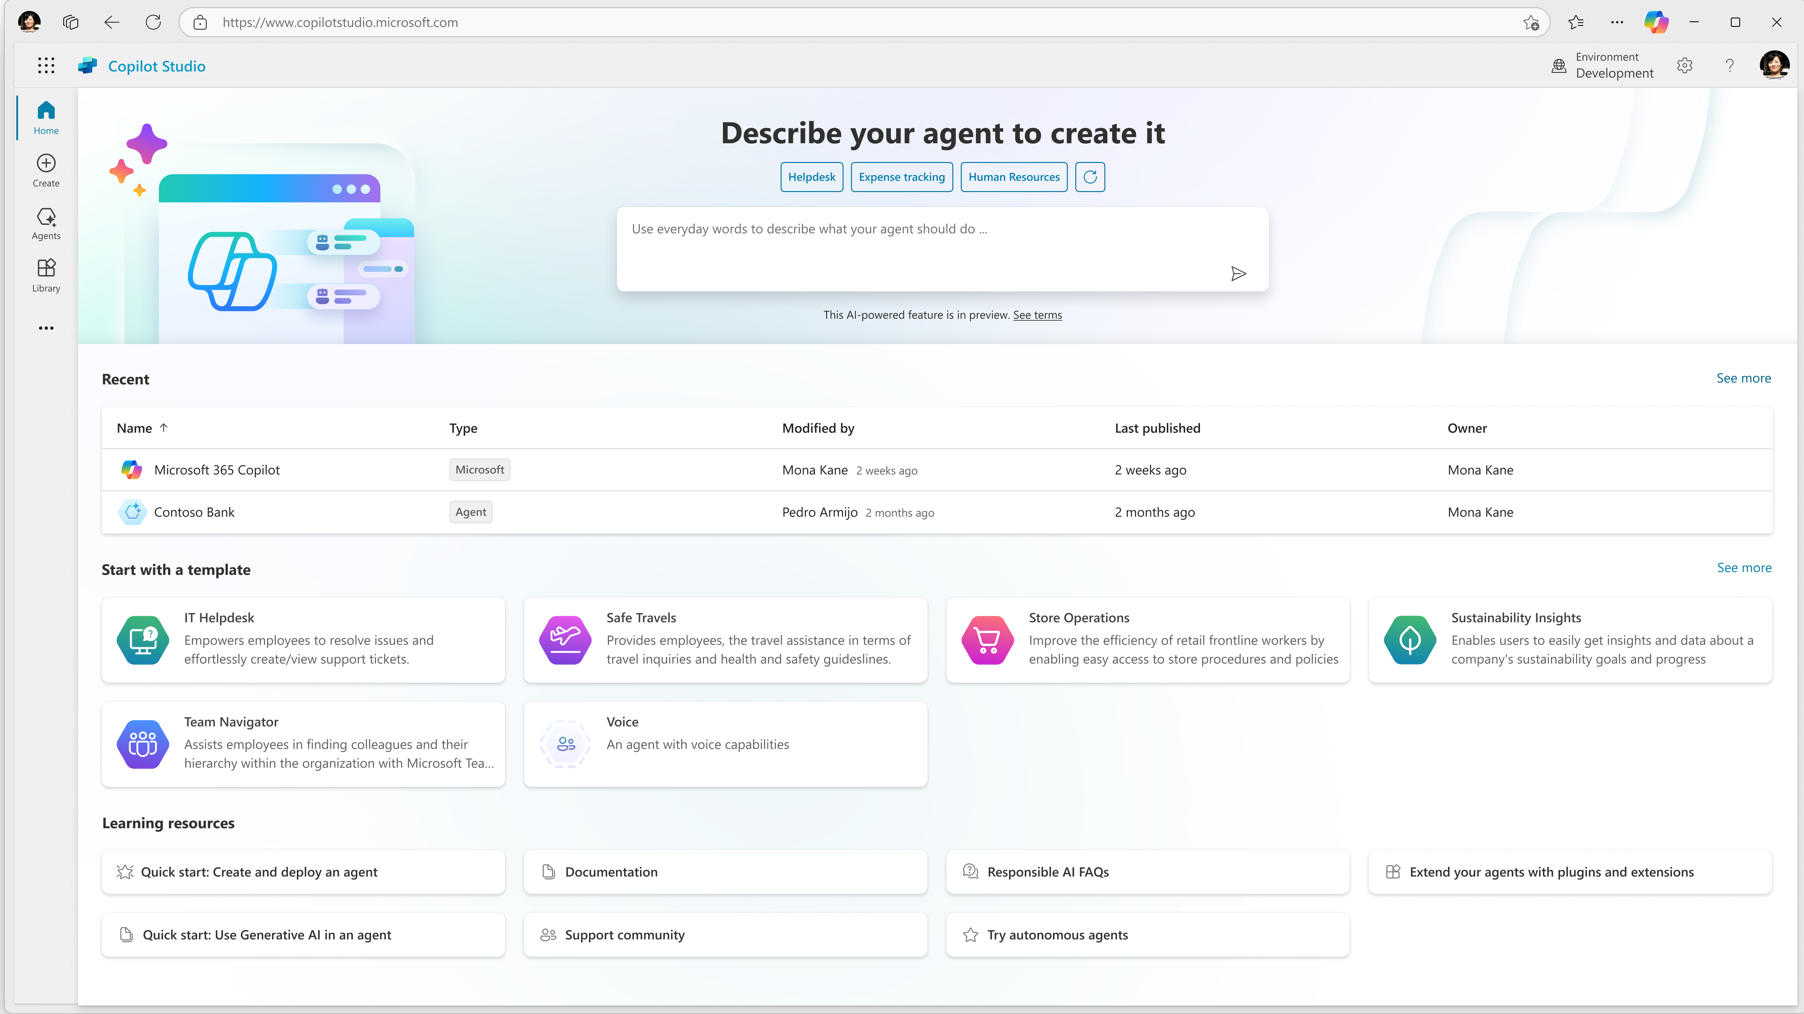
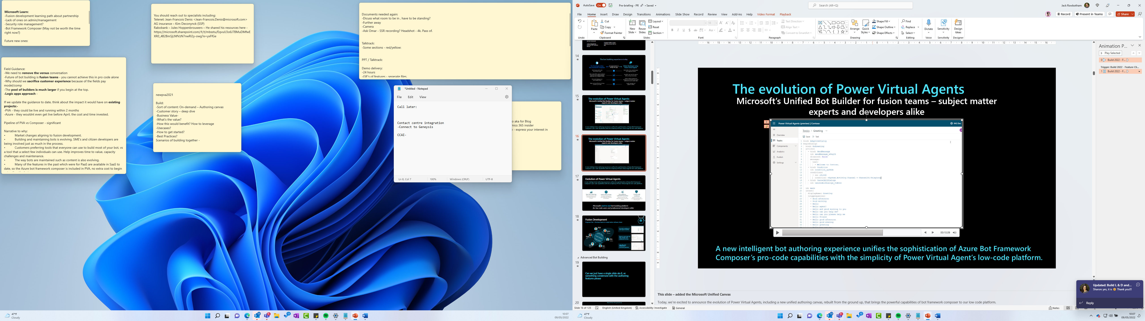


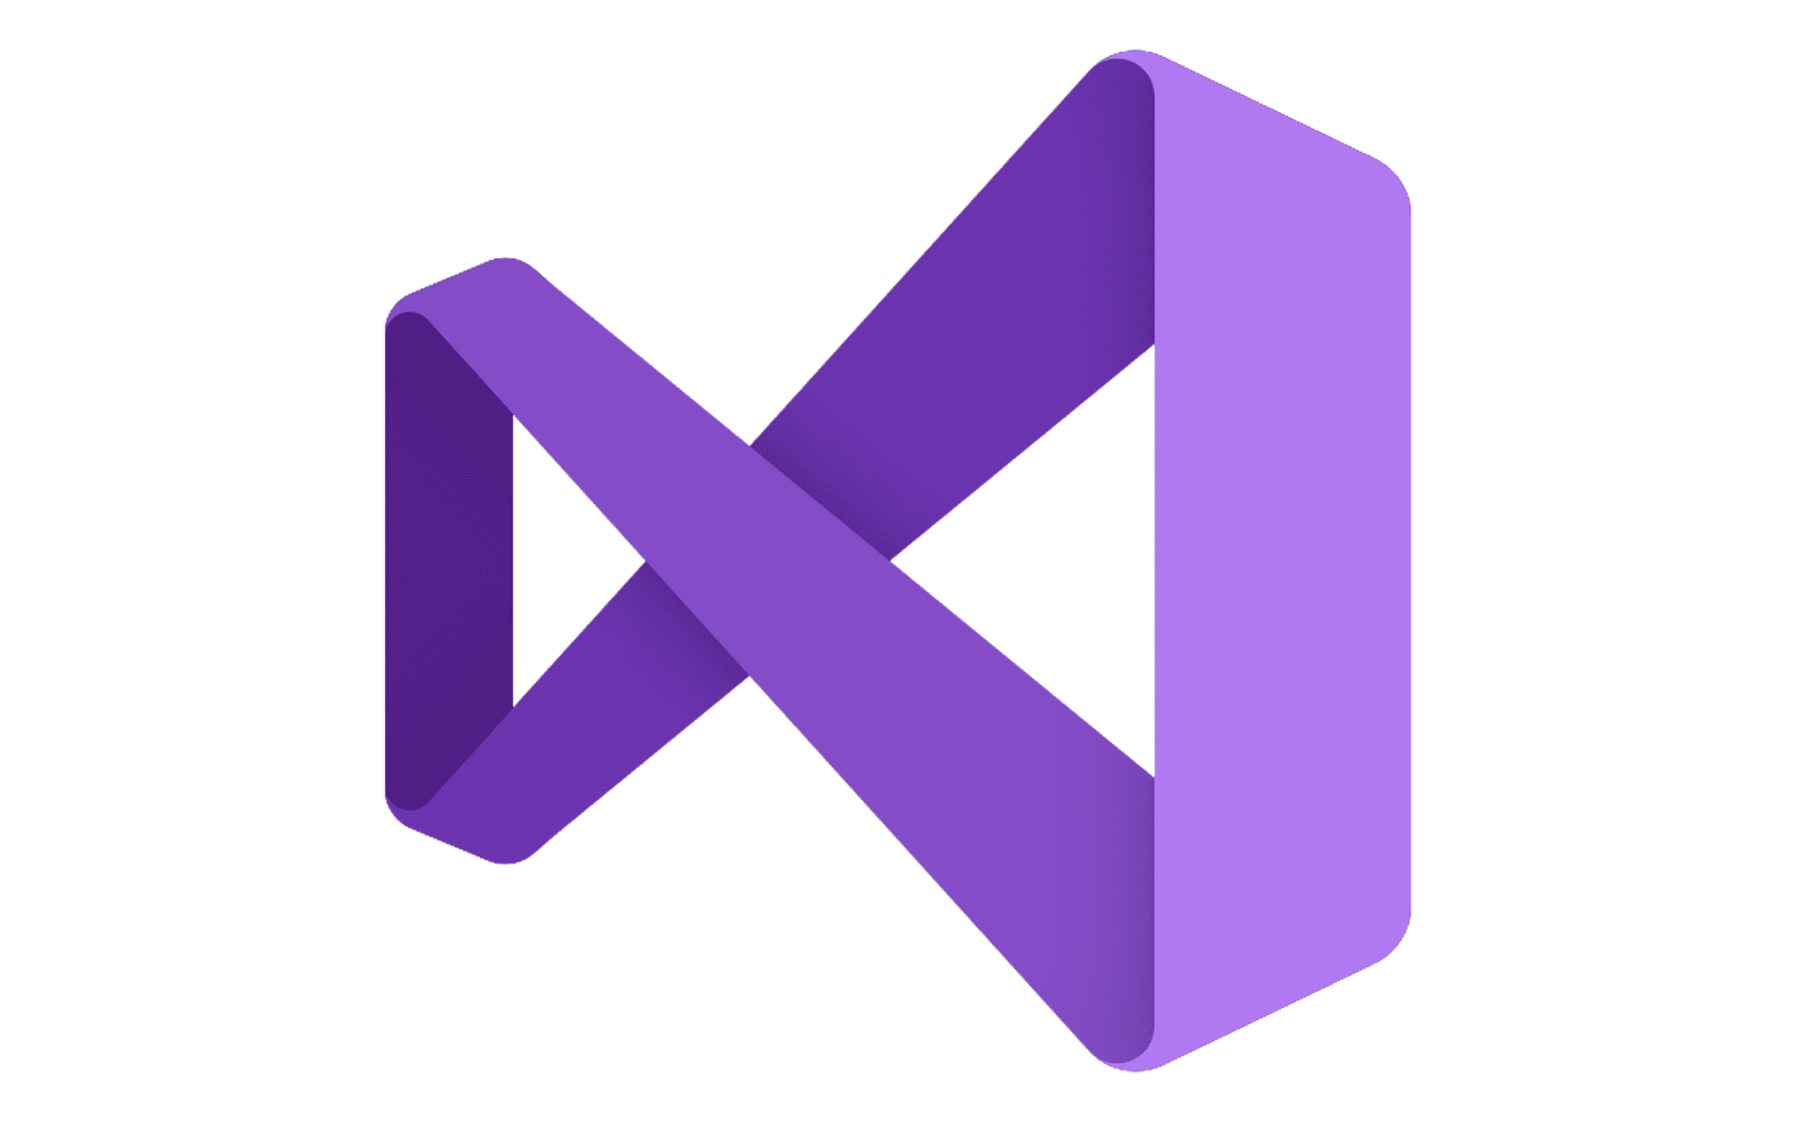

Meeting where you are in your agent-building journey
Natural Language
Code first
Agent builder
Copilot Studio
Copilot Studio + Visual Studio/GitHub
For end users
For makers
Powered by Azure AI Agent Service
For developers
Notes:
Microsoft offers different tools for getting started, depending on your level of technical skill. For all users, there's the Agent builder, which is a no-code option for making custom Copilots. For users that are a bit more technical (but perhaps not software engineers), Copilot Studio is a way to build Copilots with minimal code, but more flexibility. Finally, for developers, Copilot Studio integrates with Visual Studio Code and allows you to customize your Copilot agent much more.

Slide 19



1
2
Single agent
Multi-agent
Deploy agents with Azure AI Agent Service
Orchestrate them together with AutoGen and Semantic Kernel
Managed agent micro-services
State-of-the-art research SDK
Production-ready and stable SDK
Ideation
Production
Notes:
Developers always ask what AI Agent frameworks to use for coding your first agent.
For a single agent scenario, Microsoft offers the Azure AI Agent service and SDK, which basically creates a microservice for your agent, complete with thread storage.
For multi-agent scenarios, Microsoft offers two libraries that can make orchestration easier:
Autogen, from Microsoft Research, which includes state-of-the-art orchestration strategies
Semantic Kernel, which is designed more for production scenarios but brings in some of the strategies from AutoGen

Slide 20
But how do you make good AI agents?
Notes:
Okay, but there's a difference between making an agent and making a *good* agent. What are the characteristics of a high-quality agent? Let's explore!

Slide 21
Agentic design principles
Space
Time
Core
Notes:
Let's go through these three design principles: Space, Time, and Core.
Agent (Space)
This is the environment in which the agent operates. These principles inform how we design agents for engaging in physical and digital worlds.
Connecting, not collapsing – help connect people to other people, events, and actionable knowledge to enable collaboration and connection.
Agents help connect events, knowledge, and people.
Agents bring people closer together. They are not designed to replace or belittle people.
Easily accessible yet occasionally invisible – agent largely operates in the background and only nudges us when it is relevant and appropriate.
Agent is easily discoverable and accessible for authorized users on any device or platform.
Agent supports multimodal inputs and outputs (sound, voice, text, etc.).
Agent can seamlessly transition between foreground and background; between proactive and reactive, depending on its sensing of user needs.
Agent may operate in invisible form, yet its background process path and collaboration with other Agents are transparent to and controllable by the user.
Agent (Time)
This is how the agent operates over time. These principles inform how we design agents interacting across the past, present, and future.
Past: Reflecting on history that includes both state and context.
Agent provides more relevant results based on analysis of richer historical data beyond only the event, people, or states.
Agent creates connections from past events and actively reflects on memory to engage with current situations.
Now: Nudging more than notifying.
Agent embodies a comprehensive approach to interacting with people. When an event happens, the Agent goes beyond static notification or other static formality. Agent can simplify flows or dynamically generate cues to direct the user’s attention at the right moment.
Agent delivers information based on contextual environment, social and cultural changes and tailored to user intent.
Agent interaction can be gradual, evolving/growing in complexity to empower users over the long term.
Future: Adapting and evolving.
Agent adapts to various devices, platforms, and modalities.
Agent adapts to user behavior, accessibility needs, and is freely customizable.
Agent is shaped by and evolves through continuous user interaction.
Agent (Core)
These are the key elements in the core of an agent’s design.
Embrace uncertainty but establish trust.
A certain level of Agent uncertainty is expected. Uncertainty is a key element of agent design.
Trust and transparency are foundational layers of Agent design.
Humans are in control of when the Agent is on/off and Agent status is clearly visible at all times.

Slide 22
What are agentic design patterns?
Notes:
Now let's look at design *patterns*: common ways of designing agentic flows to incorporate tools, knowledge, and actions.

Slide 23






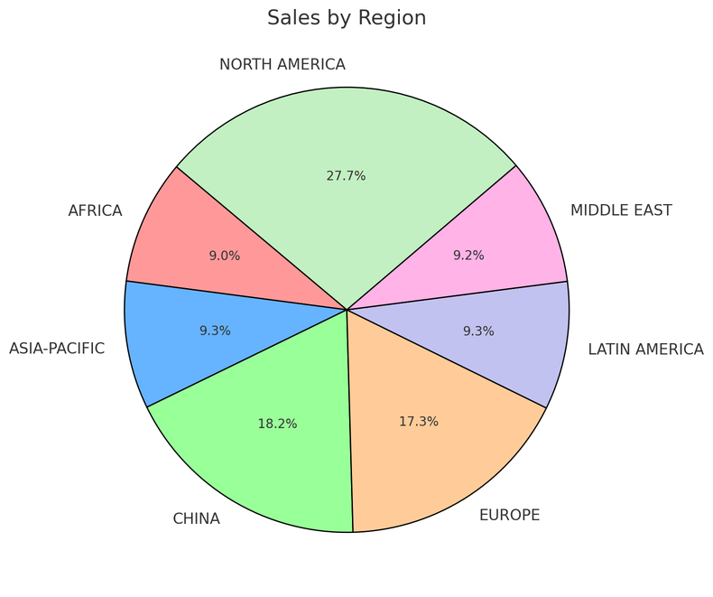
Tool integration in conversational agents
Thread
Run #1
Sales agent
User message
Tell me the total sales
by region
Instructions: You are an advanced sales analysis agent for Contoso, specializing in assisting users with sales data inquiries.
1
Query SQLite DB
SELECT * FROM
sales GROUP BY region
Agent message
Here is the sales:
Europe: $15478.00
America: $78792.00
2
Create message
Model
Tools
File Search Code Interpreter
Query SQLite Bing Search Microsoft SharePoint
Microsoft Fabric Azure Logic Apps
Azure Functions
User message
Show as a pie chart
Run #2
Code Interpreter Tool
Create a pie chart
Data
1
Agent message
Azure AI Search
Files (Azure Blob)
2
Create message
Notes:
This slide has lots of annimations
So, a bit more of a drill down
High level – this is how the AI Agent Service works
Create/define agent,
Create a thread which is a unit of conversation
Run the Agent
Check status till complete
Show output
Break this down futher

Slide 24

Tool integration in Agentic RAG
Documents
User question
Database
Verify
Quality
Gather results
LLM
Analysis
Custom APIs
Web search
✅ Good
Quality
❌ Insufficient
Update memory
Generate response
Notes:
RAG, Retrieval-Augmented Generation, is a way of getting an LLM to answer questions about your own data, by first retrieving relevant context and sending that to the LLM. There are many ways that we can improve RAG through agentic design patterns to increase the accuracy of the answers.
In this diagram, we send the user question to an LLM for initial analysis. It decides what tools to call and how to call them in order to find results, searching multiple places for relevant information. Then we collect the results together, and use either a model or algorithm to decide if the quality is high enough. If not, we repeat the retrieval step, but if so, we send the results to the LLM to generate a response. Finally, we remember the interaction in memory, for future reference.

Slide 25
Model Context Protocol
A standard way that can applications can provide context and tools for LLMs
Your local computer
MCP Host
Claude, GitHub Copilot, ...
MCP Server A
MCP Client A
MCP
Tools
Prompts
Resources
MCP Server B
MCP Client B
MCP
Remote data
Tools
Prompts
Resources
https://modelcontextprotocol.io/

Slide 26
Building trustworthy AI agents
Notes:
If we're going to use agents for business automation – to actually take actions – we need a high degree of confidence in their accuracy.

Slide 27
System message framework
System message
Agent
System message
for generating
system messages
System message
Agent
System message
Agent
LLM
Basic
system message
System message
Agent
Notes:
https://learn.microsoft.com/azure/ai-services/openai/concepts/system-message?tabs=top-techniques

Slide 28
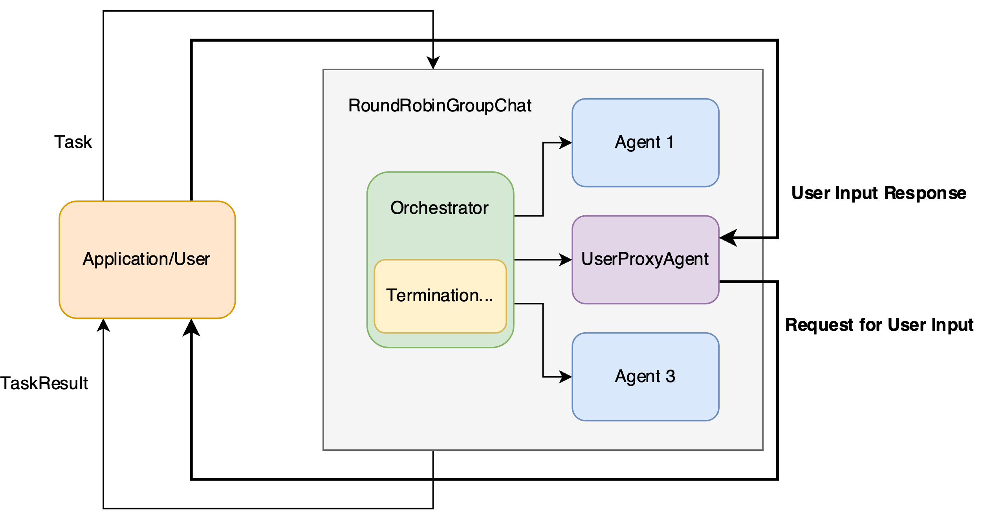
Human-in-the-loop
Notes:
For systems that need high accuracy, we will often need a way to bring in humans. A human can provide missing information, it can approve any actions that have low confidence, it can interact with users that are having a hard time getting what they need from an agent (like for customer support). Even if we bring humans in to handle 5% of cases, using AI agents can still help us speed up 95% of a business process.

Slide 29
Human-in-the-loop
User
goal
The user goal
was achieved by the agent
User
agent
Response sent
to the user agent
The work was
completed or continued
AI Agent
AI
Agent
Notes:
For systems that need high accuracy, we will often need a way to bring in humans. A human can provide missing information, it can approve any actions that have low confidence, it can interact with users that are having a hard time getting what they need from an agent (like for customer support). Even if we bring humans in to handle 5% of cases, using AI agents can still help us speed up 95% of a business process.

Slide 30
Evaluating AI agents
User question
"What's weather tomorrow?"
Intent resolution
User wants to know local weather for their location
Tool calls
Call location + time API
Call weather API
Final response
"The temperature will be 30 degrees. Rain will..."
User intent identification
Clarification for ambiguity
Correct tool call selection
Correct parameter extraction
Task adherence
Response completeness
EVALUATION
Quality and safety evaluation throughout agent interactions as appropriate
RAG quality – Groundedness / Relevance / Retrieval
Risks and Safety – Jailbreak/Code Vulnerabilities/Ungrounded Attributes
https://learn.microsoft.com/azure/ai-foundry/how-to/develop/agent-evaluate-sdk

Slide 31
My advice on building AI agents
Notes:
Finally, here's some advice from my colleagues that have developed agents.

Slide 32

It's very fun!
Notes:
First, it's really fun! It's amazing to see what these new techmologies can do.

Slide 33
But can be very hard!
"If you think we are close to AGI,
try building an AI Agent."
- Someone on the internet
Notes:
However, it can also be very difficult, especially when you start testing your system with real data and real user input.

Slide 34
Don't give up!
List the tools and knowledge needed
Diagram the Agent Flow
Develop each agent/tool iteratively
Hardcode first if needed to test
Don’t over commit to one tool/pattern
Notes:
But just because it's hard, that doesn't mean you should give up!
Here are the steps that I recommend...

Slide 35
Intro to
Agents
AI agent
Frameworks
Design patterns
AI Agents
Tool use
For Beginners
Agentic RAG
Trustworthiness
Planning
Multi-agents
Metacognition
Agents in Production
aka.ms/ai-agents-beginners
Notes:
This part of the presentation is based in free agents curriculum that's available online, and is translated into portuguese too.
You can dive way more into these concepts after this talk from that link.

Slide 36
Building an agent with Microsoft technologies

Slide 37
Agent components
Component | Options
LLM: The model making all the decisions and generating responses | Azure OpenAI, Azure AI Model Catalog, GitHub Models, Local Phi models
Orchestrator: A framework to manage the sequence of calls to LLMs | Semantic Kernel (Python/C#), AutoGen (Python), Azure AI SDK OSS packages with Azure compatibility: Langchain, Llamaindex, CrewAI, ...
Data stores: Places to either retrieve knowledge for LLMs, or store results of agentic workflows | Azure AI Search, Azure Cosmos DB, Azure Database for PostgreSQL, Azure SQL
Tools: Services that empower the LLMs with more functionality | Azure Document Intelligence & Content Understanding, Azure Speech APIs, Bing Search, Azure Communication Services,...

Slide 38

LLM options
"Agentic Voice Mode Unplugged"
April 17, Seth Juarez
"VoiceRAG: talk to your data"
April 22, Enrique Moreno Cano
and many more sessions!
Azure OpenAI
Includes gpt-4o, realtime,
o3-mini, embedding-3,...
Azure AI Model Catalog
Includes models from DeepSeek, Mistral, Cohere, Jamba, Phi, HuggingFace, ...
"Building an agent with an army of models"
April 16, Facundo Santiago
GitHub Models Includes models from DeepSeek, Mistral, Cohere, Jamba, Phi... FOR FREE!
"Prototyping AI agents with GitHub Models"
April 15, Pamela Fox

Slide 39
Azure AI Agents Service
The agents service
is part of AI Foundry
and makes it easier
to use built-in tools
and observability to agentic code.
"Build your code-first app with Azure AI Agent Service"
April 9, 9 AM PT, Carlotta Castelluccio, Marlene Mhangami
April 9, 3 PM PT, Dave Glover
"Build your code-first app with Azure AI Agent Service (.NET)"
April 10, 3 PM PT, Aaron Powell
"Your first AI Agent in JS with Azure AI Agent Service"
April 15, 7 AM PT, Wassim Chegham
"Extending AI Agents with Azure Functions"
April 24, Eamon O'Reilly, Nick Greenfield

Slide 40
Orchestrators from Microsoft
"Transforming business processes with multi-agent AI using Semantic Kernel"
April 10, Shawn Henry
"Multi-agent AI with Semantic Kernel + Azure Cosmos DB"
April 16, Sajeetharan Sinnathurai, Abhishek Gupta
"Multi-Agent solutions with SignalR, gRPC, and HTTP using Semantic Kernel"
April 22, Brandon Hurlburt
Semantic Kernel
Python and C#
AutoGen
Python
"Building Agentic Applications with AutoGen v0.4"
April 15, Jack Gerrits, Eric Zhu

Slide 41
OSS orchestrators
Llamaindex
Python + JS
(Talk only in JS)
"Knowledge-augmented agents with LlamaIndex.TS"
April 21, Laurie Voss
Langchain
Python,
JS,
and Java
versions
"Building Java AI Agents using LangChain4j and Dynamic Sessions"
April 17, Brian Benz
"Multi-agent API with LangGraph and Azure Cosmos DB"
April 16, Aayush Kataria, James Codella, Theo van Kraay

Slide 42
Data stores
"Multi-agent AI with Semantic Kernel + Azure Cosmos DB"
April 16, Sajeetharan Sinnathurai, Abhishek Gupta "Multi-agent API with LangGraph and Azure Cosmos DB"
April 16, Aayush Kataria, James Codella, Theo van Kraay
Azure
Cosmos DB
Azure
AI Search
"Mastering Agentic RAG"
April 16, Farzad Sunavala
"VoiceRAG: talk to your data"
April 22, Enrique Moreno Cano
"Agentic RAG with reflection"
April 23, Matt Gotteiner

Slide 43
Data stores (SQL)
Azure SQL
"Demystifying Agents: Building an AI Agent from Scratch on Your Own Data using Azure SQL"
April 22, Davide Mauri
Azure
Database for
PostgreSQL
"Building Multi-Agent Apps on top of Azure PostgreSQL"
April 23, Arnaud Comet, Mehrsa Golestaneh
"Multi-source data patterns for modern RAG apps"
April 23, Gary Hope

Slide 44
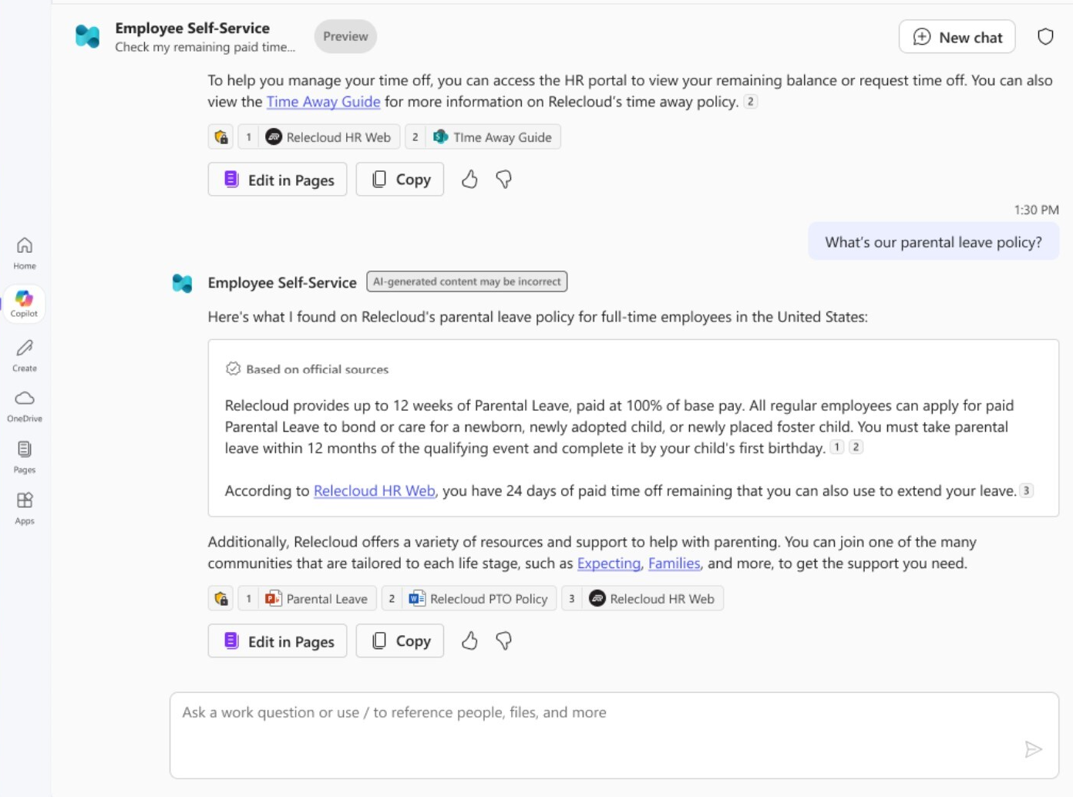



Where will the agent live?
Embedded agents in Microsoft 365
Deployed agents in Azure cloud
App Service
Container Apps
Kubernetes Service
Functions
https://developer.microsoft.com/reactor/series/S-1505

Slide 45
Microsoft 365 Copilot Agents
Use either
Copilot Studio
or 365 Agents SDK
to build agents embedded in M365.
"Build and extend agents for Microsoft 365 Copilot"
April 10, Kamal Shree, Paolo Pialorsi
"Building custom engine agents with Azure AI Foundry and Visual Studio Code"
April 14, Ayca Bas
"Building Declarative Agents with Microsoft Copilot Studio & Teams Toolkit"
April 16, Daniel Laskewitz, Garry Trinder

Slide 46
Deployed agents in Azure Cloud
Azure Functions
"Extending AI Agents with Azure Functions"
April 24, Eamon O'Reilly, Nick Greenfield
Azure Container Apps
"Building Java AI Agents using LangChain4j and Dynamic Sessions"
April 17, Brian Benz
"Building smarter Python AI agents with code interpreters"
April 17, Anthony Chu

Slide 47
Next steps

Slide 48
AI Agents Hackathon: Next steps
Register for the hackathon @ aka.ms/agentshack/register
Got questions? post in GitHub forum or attend Discord Office Hours.
Join the community @ aka.ms/agentshack/discord
Attend more live expert sessions! aka.ms/agentshack/streams
Submit your project before April 30th 11:59 PM PT to win prizes! 💵
Notes:
Josh: Hi everyone, hope you enjoyed today's session! If you aren't registered for the AI Agents hackathon yet, register now at aka.ms/agentshack and start hacking on the agent of your dreams.
Pamela: If you have any questions along the way, post in our discussion forum or attend live office hours in Discord. And of course, make sure to join our upcoming live streams to keep learning about agents.
Josh: Once your project is ready, submit it before April 30th at 11:59PM PT to be eligible for our prizes. Thanks for joining!

